Slide 1
Bridging Causal Inference and Machine Learning in Python: An Evaluation of Leading Libraries such as DoWhy, CausalML, EconML, CausalNex and Double Machine Learning
Dahye Jeong

Slide 2
Aims of the Dissertation
Create the synthetic data with the continuous and binary treatments
Compare the different python libraries for the causal inference using evaluation metrics

Slide 3
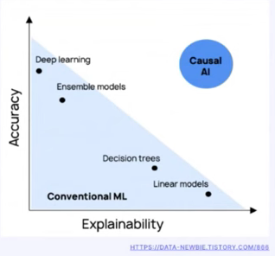
Table of Contents
Causal Inference
Research Design
Synthetic Data Generation Process
Exploration Data Analysis
Python Libraries
Evaluation Metrics

Slide 4
Causal Inference
Potential Outcome – Counterfactual
Bayesian Network
Causal inference with Linear Regression
SEM(Structural Equation Modelling)
DAG (Directed Acyclic Graphs)
Instrumental Variable Analysis

Slide 5
Causal Method | Python Libraries | Function Used | Obtainable Outcome
Propensity Score Matching | CausalML, DoWhy | LinearPropensityScore | Average Treatment Effect, Average Treatment effect on Treated
Instrumental Variables | CausalInference, DoWhy | InstrumentalVariableEstimator | Local Average Treatment Effect
Difference-in-Differences | CausalInference, EconML | DIDEstimator | Treatment effect with time and group variations
Regression Discontinuity | CausalInference, DoWhy | RDEstimator | Local treatment effect around a threshold
Causal Forests | EconML | CausalForestDML | Heterogeneous treatment effects
Bayesian Networks | CausalNex | from_pandas | Probabilistic causal relationships
Double Machine Learning | EconML | DMLCateEstimator | Treatment effect controlling for confounding
Linear Regression | scikit-learn, statsmodels | LinearRegression, OLS | Average Treatment Effect (under certain assumptions)

Slide 6
Method | Regression |  | Regression |  |  |  |  |  | Instrumental Variables |  | Bayesian Network
 | Linear Regression |  | Linear Regression |  | DoubleML |  | Meta-Learner |  |  |  | Bayesian Network
Python libraries | statsmodels (OLS) |  | DoWhy |  | EconML |  | CausalML |  | DoWhy |  | CausalNex
Evaluation Data Structure | ATE | MAPE | ATE | MAPE | ATE | MAPE | ATE | MAPE | ATE | MAPE | ATE | MAPE
data1
data2
data3
data4
statsmodels : Direct causes vs all of the variables
Dowhy : get all the coefficients of the arrows
**Estimation of causal graphs (has been estimated)
**Comparing coefficients of all the variables.(Direct causes)
-> Obtain predictions -> MAPE
RCT: treatment assignment is random and independent of covariates.
Notes:
All variables -> Regression ->> coefficients and prediction -> DONE
All variables -> Dowhy -> coefficient and prediction
Introduce the noise to the graph by changing arrow at random -> Dowhy -> coefficient and prediction
All variables -> Neural Network -> prediction
Prediction should not be with train (coefficient). Should be in test dataset.
Synthetic data + 1 real data
Image built from the references ->

Slide 7

Synthetic Data Type
Data Structure | Intervention | Mediator | Instrument | Sample size for training | Confounders | Outcome (Remaining Life of pipeline)
data1 | Continuous | Yes | 0 | 50 100 1000 | 2 | Continuous
data2 | Continuous | No | 0 | 50 100 1000 | 1 | Continuous
data3 | Binary | Yes | 0 | 50 100 1000 | 3 | Continuous
data4 | Binary | No | 1 | 50 100 1000 | 2 | Continuous
(Sample size for test: 1000)
Data – Outcome variance is large : difficult to guess
Notes:
Towards a comparison of python libraries for causal inference and prediction
Assessment of DoWhy Python library for causal inference and prediction
Towards robustness assessment of the dowhy python library for causal inference and prediction.
Causal effect (Coefficients of Intervention), MAPE&RMSE with the predicted outcome
OLs: Regression
Dowhy : Python libraries for causal inference
CFNN: Nueral Network
Data :

Slide 8
TRUE VALUE OF COEFFICIENTS
data1:
Intervention (T)
T=β1×X1+ϵT,ϵT∼N(0,1)
Mediator (M)
M=γ1×T+β2×X2+ϵM,ϵM∼N(0,0.5)
Outcome (Y)
Y=α+γ2×T+γ1×M+β1×X1+β2×X2+β3×X3+ϵY,ϵY∼N(0,1)
data2:
Intervention (T)
T=β1×X1+ϵT,ϵT∼N(0,1)
Outcome (Y)
Y=α+γ2×T+β1×X1+β2×X2+β3×X3+ϵY,ϵY∼N(0,1)
data3:
Intervention (T)
P(T=1)=11+exp⁡(−X1−X2)
Mediator (M)
M=γ1×T+β1×X1−β2×X2+ϵM,ϵM∼N(0,1)
Outcome (Y)
Y=α+γ2×T+γ1×M+β1×X1+β2×X2+β3×X3+ϵY,ϵY∼N(0,1)
data4:
Intervention (T)
P(T=1)=11+exp⁡(−X1−X2)
Outcome (Y)
Y=α+γ2×T+β1×X1+β2×X2+β3×X3+ϵY,ϵY∼N(0,1)
COEFFICIENTS | DATA1 | DATA2 | DATA3 | DATA4
Intervention | 3 | 3 | 3 | 3
Mediator | 2 | X | 2 | X
Intercept | 3 | 3 | 3 | 3
X1 | 0.5 | 0.5 | 0.5 | 0.5
X2 | 0.6 | X | 0.6 | 0.6
X3 | 0.7 | X | 0.7 | X

Slide 9
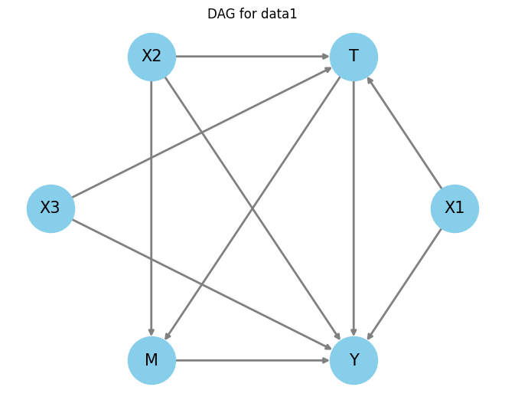
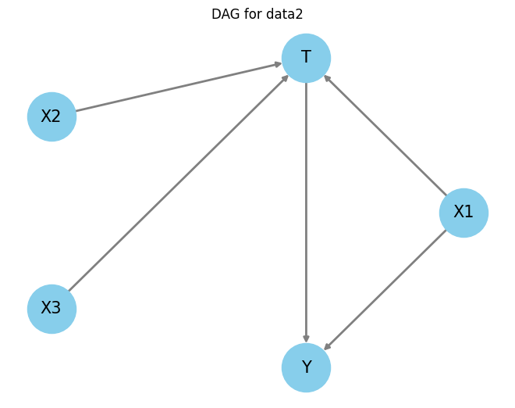
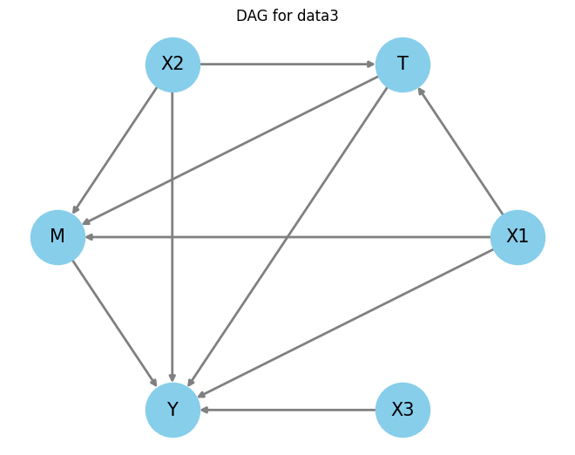
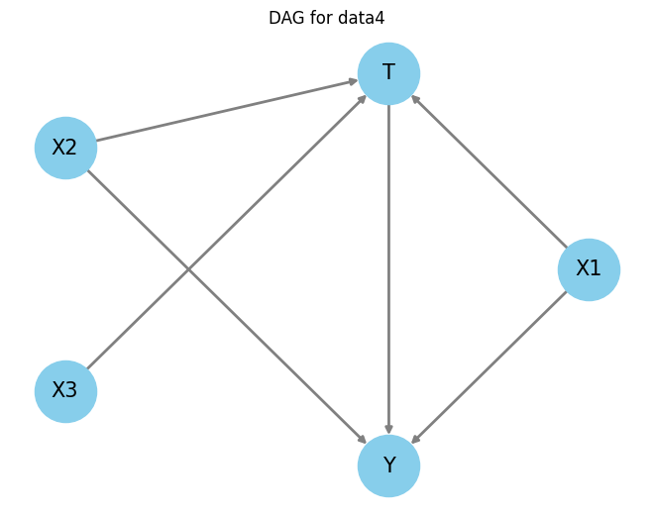
Data 1
Data 2
Data 3
Data 4

Slide 10
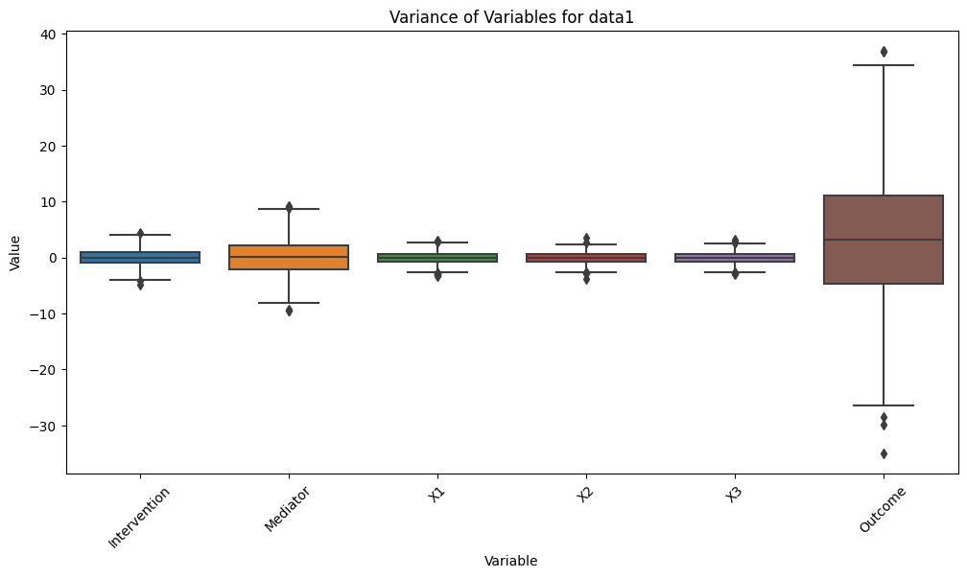
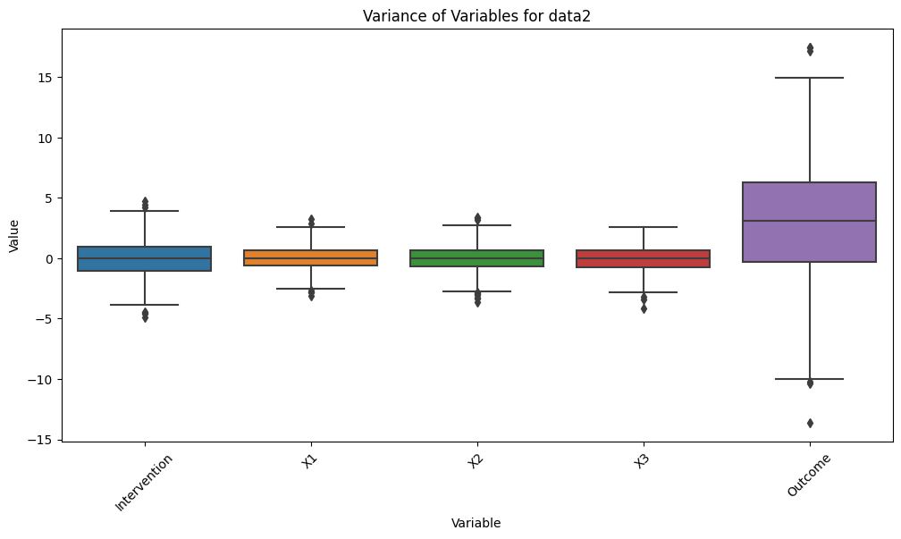
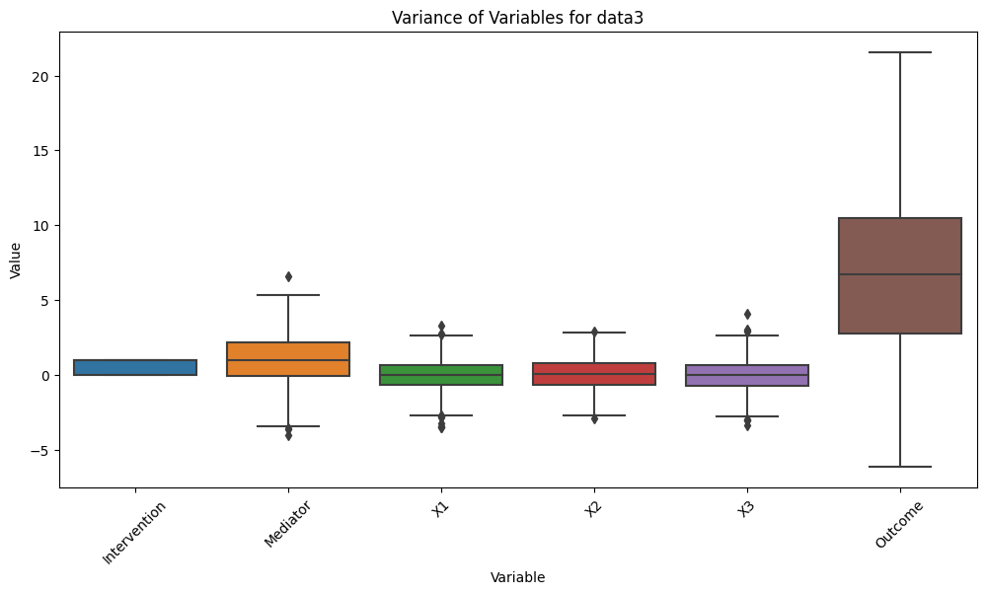
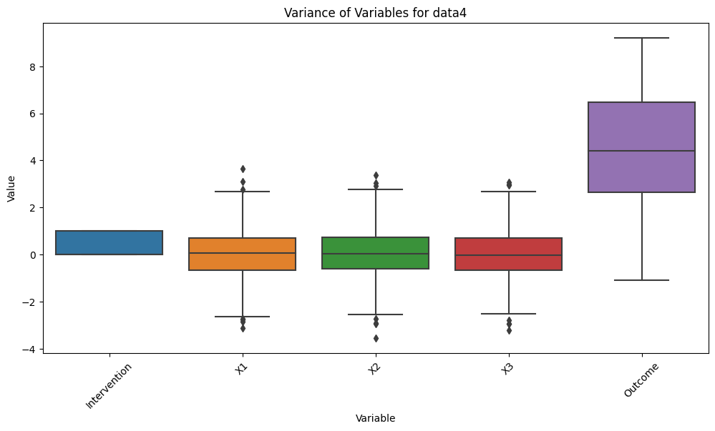
Data 1
Data 2
Intervention Mediator X1 X2 X3 Outcome
Intervention X1 X2 X3 Outcome
Data 3
Data 4
Intervention Mediator X1 X2 X3 Outcome
Intervention X1 X2 X3 Outcome

Slide 11
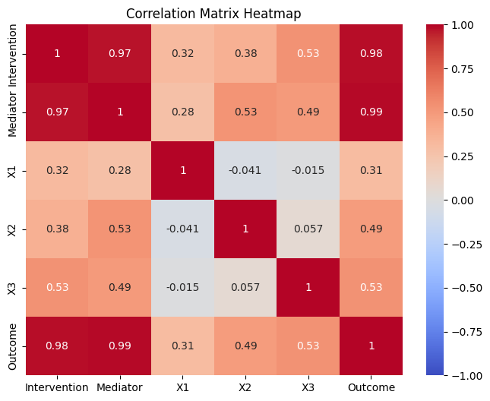
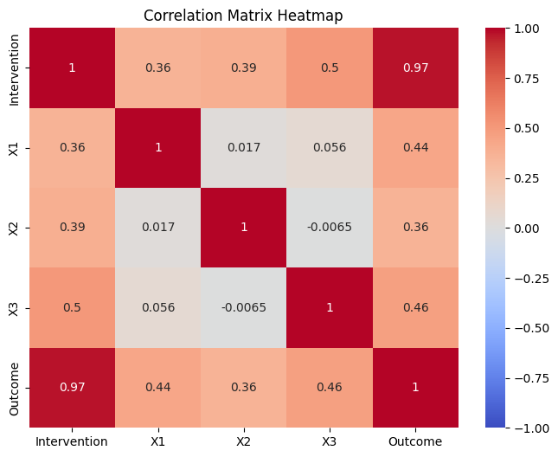
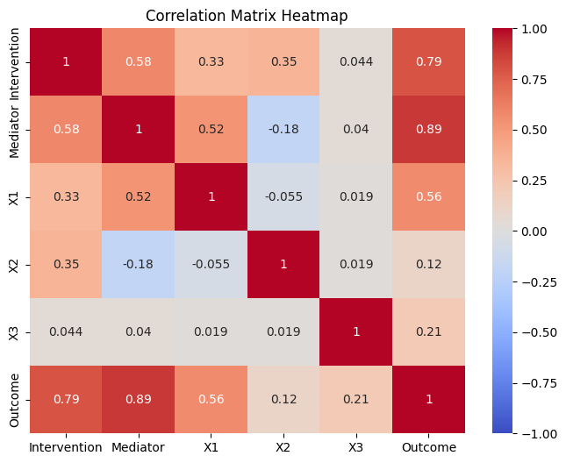
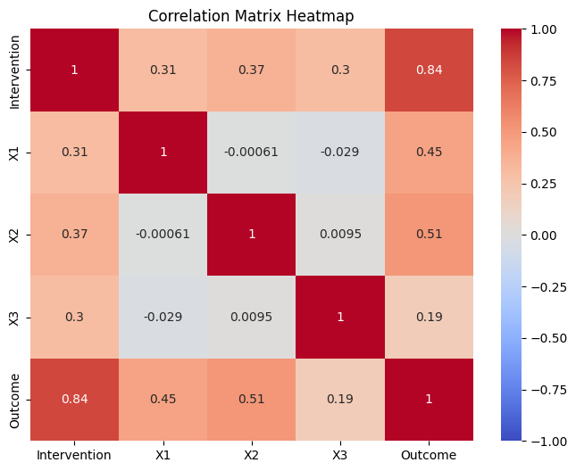
Data 1
Data 2
Intervention Mediator X1 X2 X3 Outcome
Intervention X1 X2 X3 Outcome
Intervention Mediator X1 X2 X3 Outcome
Intervention X1 X2 X3 Outcome
Data 3
Data 4
Intervention Mediator X1 X2 X3 Outcome
Intervention X1 X2 X3 Outcome
Intervention Mediator X1 X2 X3 Outcome
Intervention X1 X2 X3 Outcome

Slide 12
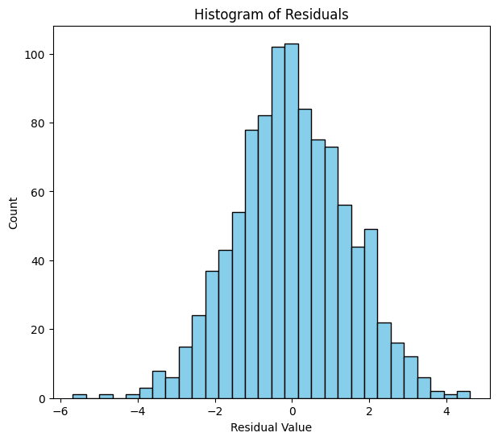
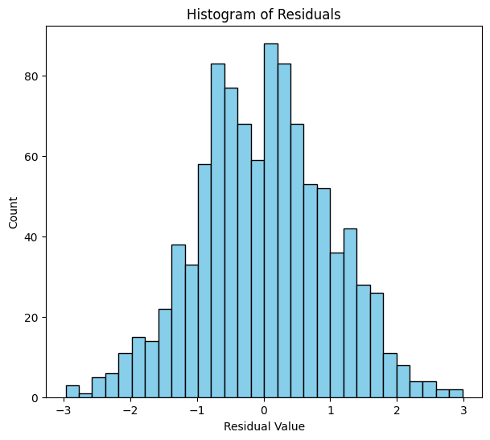
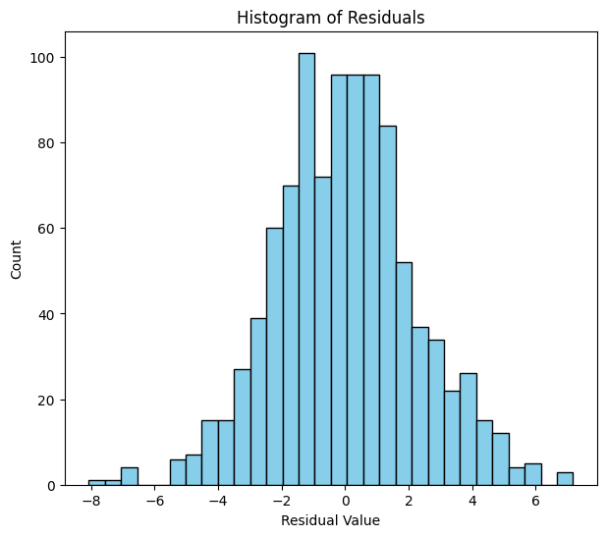
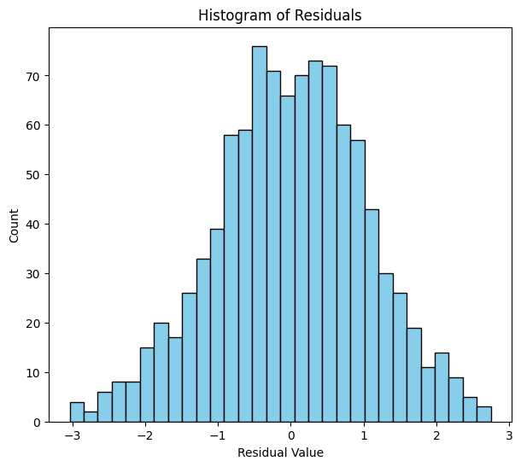
Data 1
Data 2
Data 3
Data 4

Slide 13
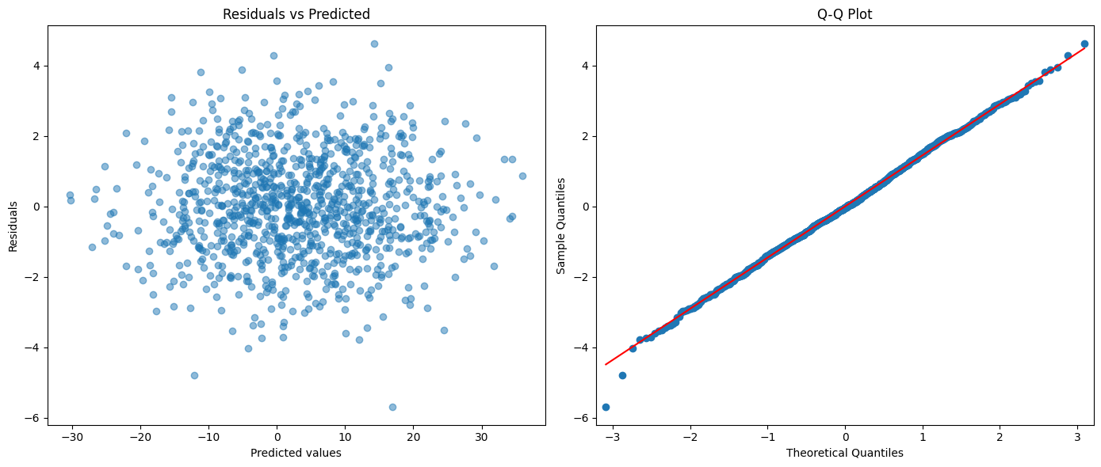
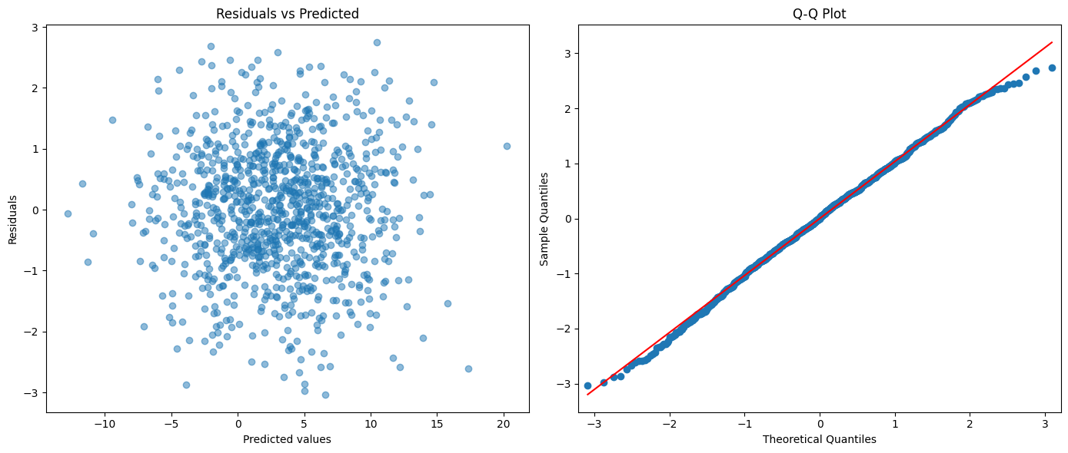
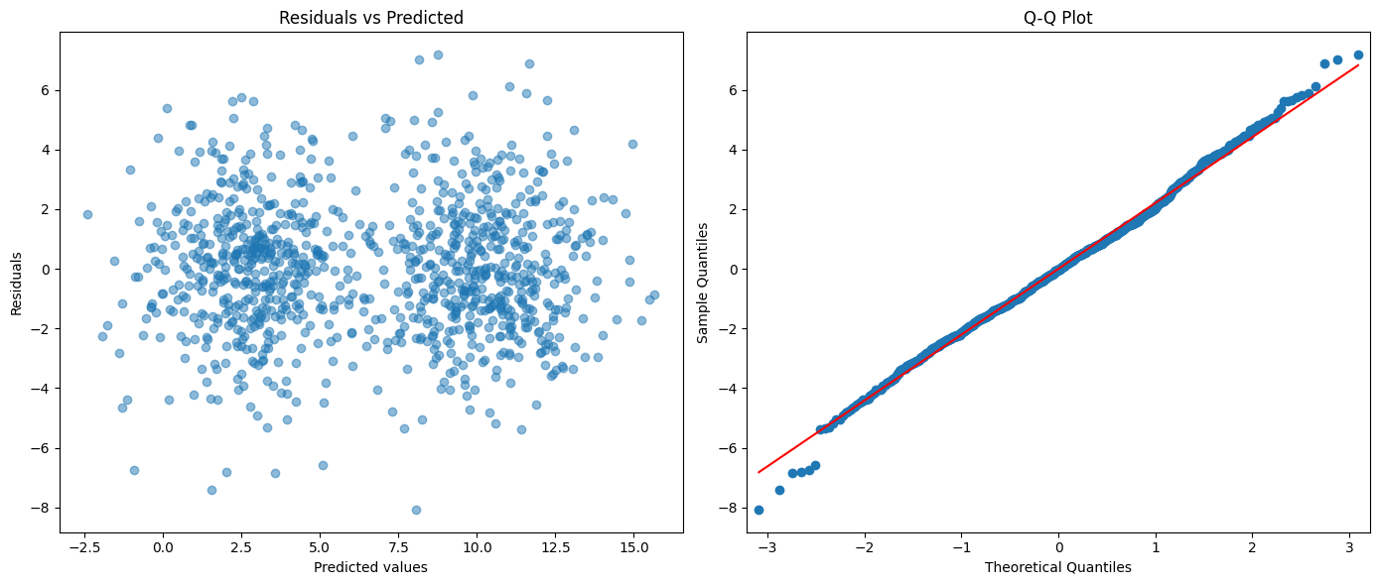
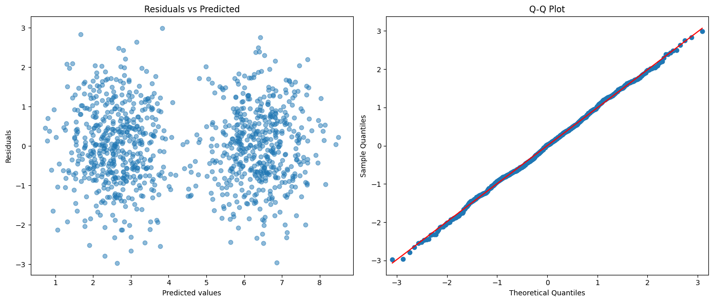

Slide 14
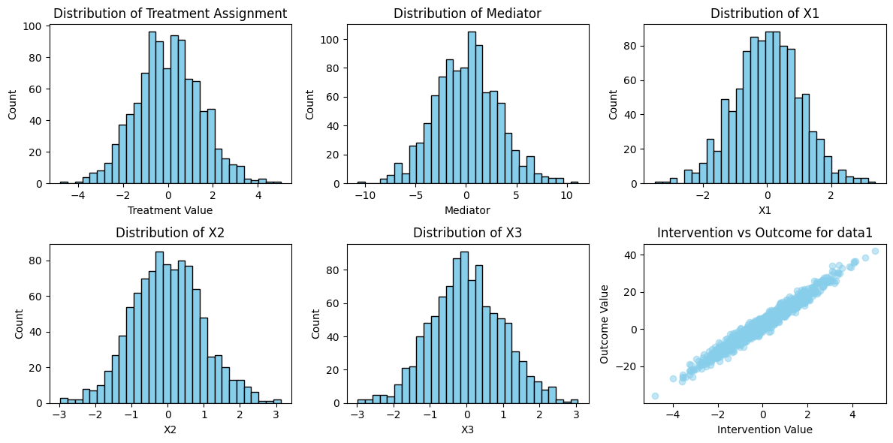
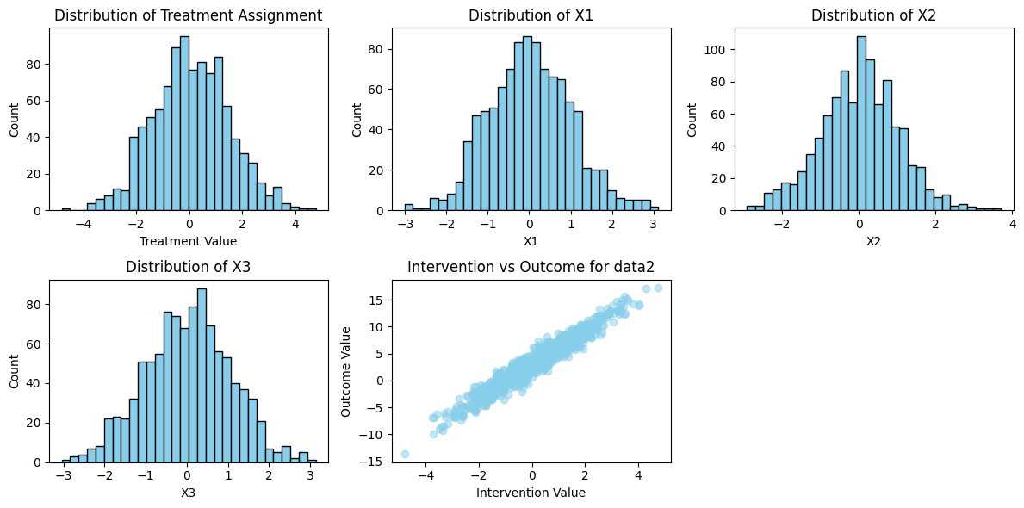
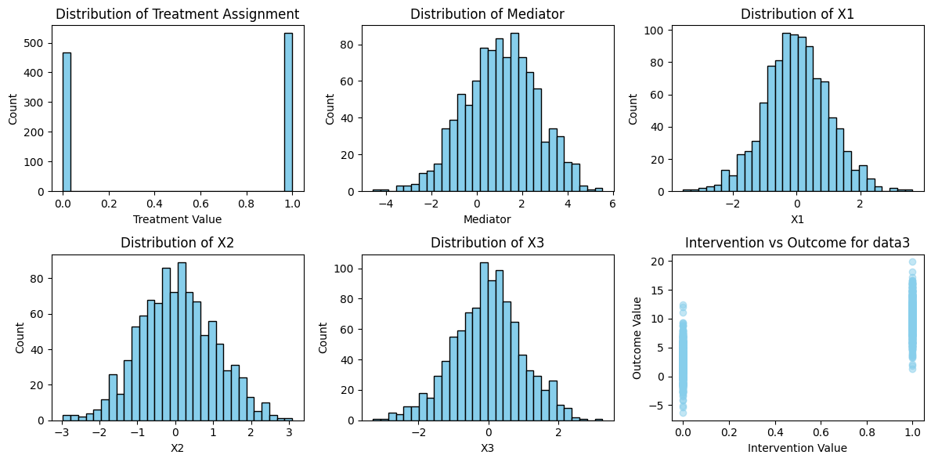
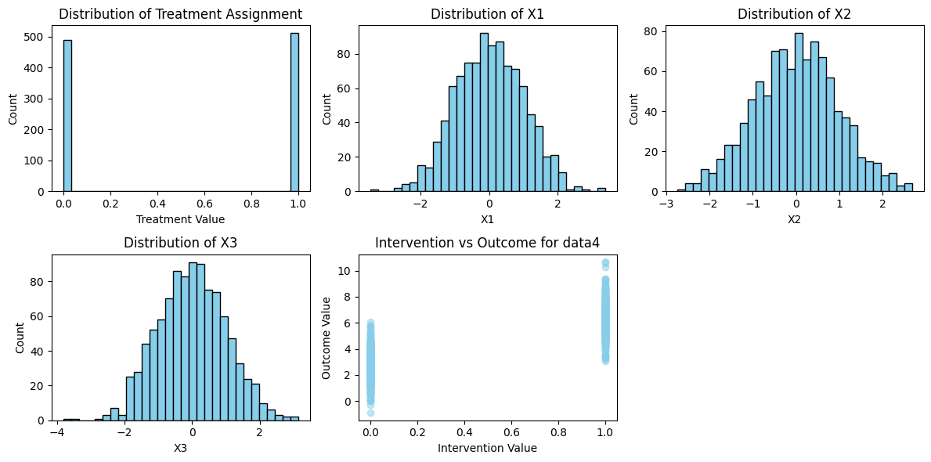
Data 1
Data 2
Intervention Mediator X1
Intervention X1 X2
X2 X3 Intervention vs Outcome
X3 Intervention vs Outcome
Data 3
Data 4
Intervention Mediator X1
Intervention X1 X2
X2 X3 Intervention vs Outcome
X3 Intervention vs Outcome

Slide 15
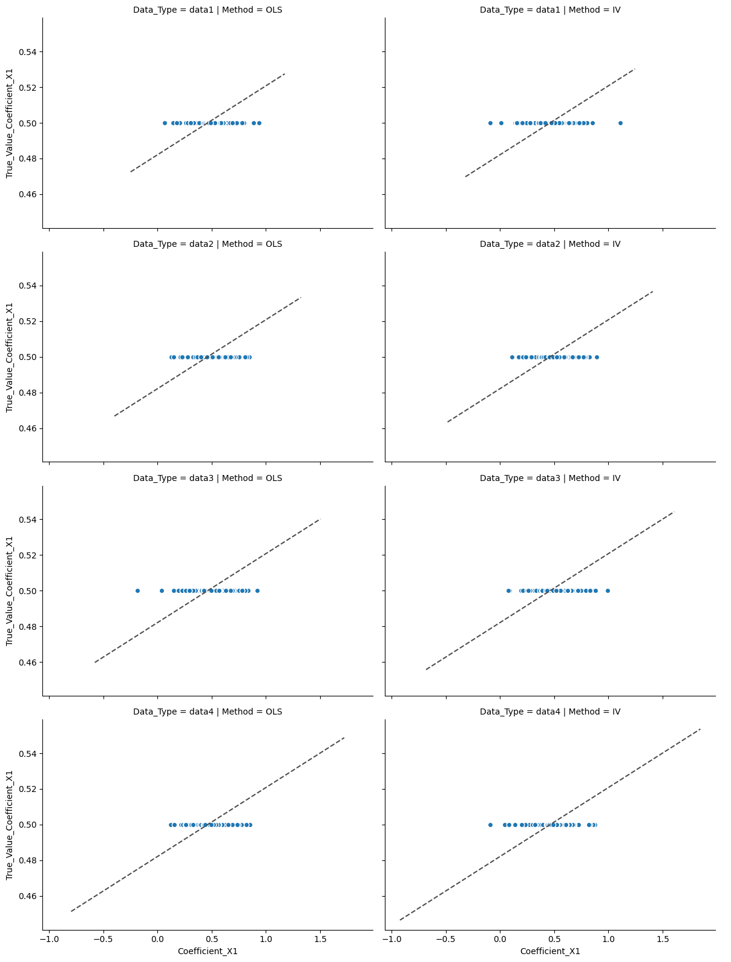
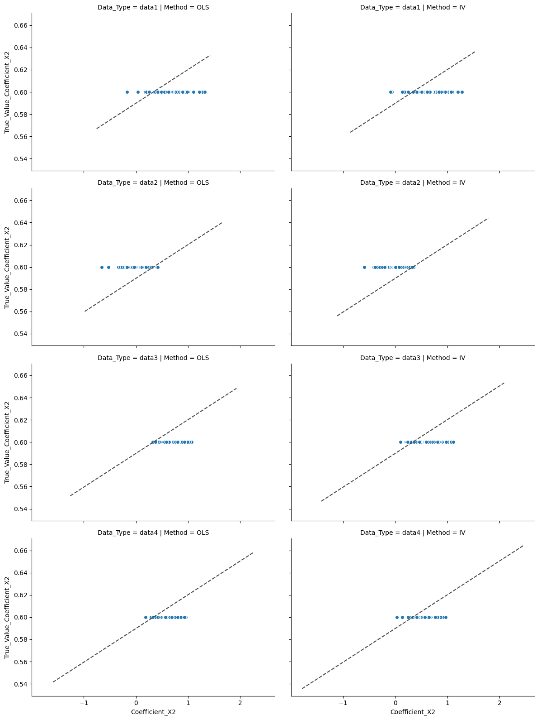
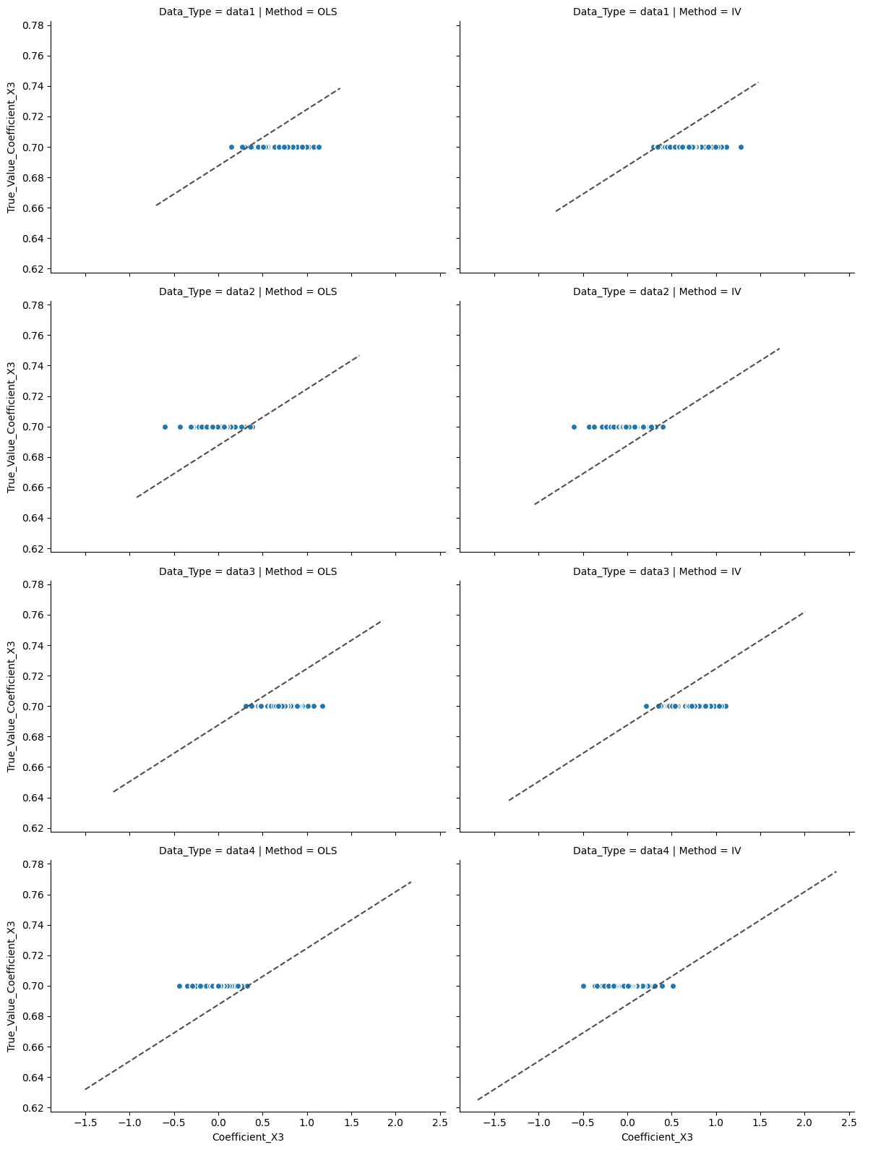
Data1
Data2
Data3
Data4
Coefficient X1
Coefficient X2
Coefficient X3

Slide 16
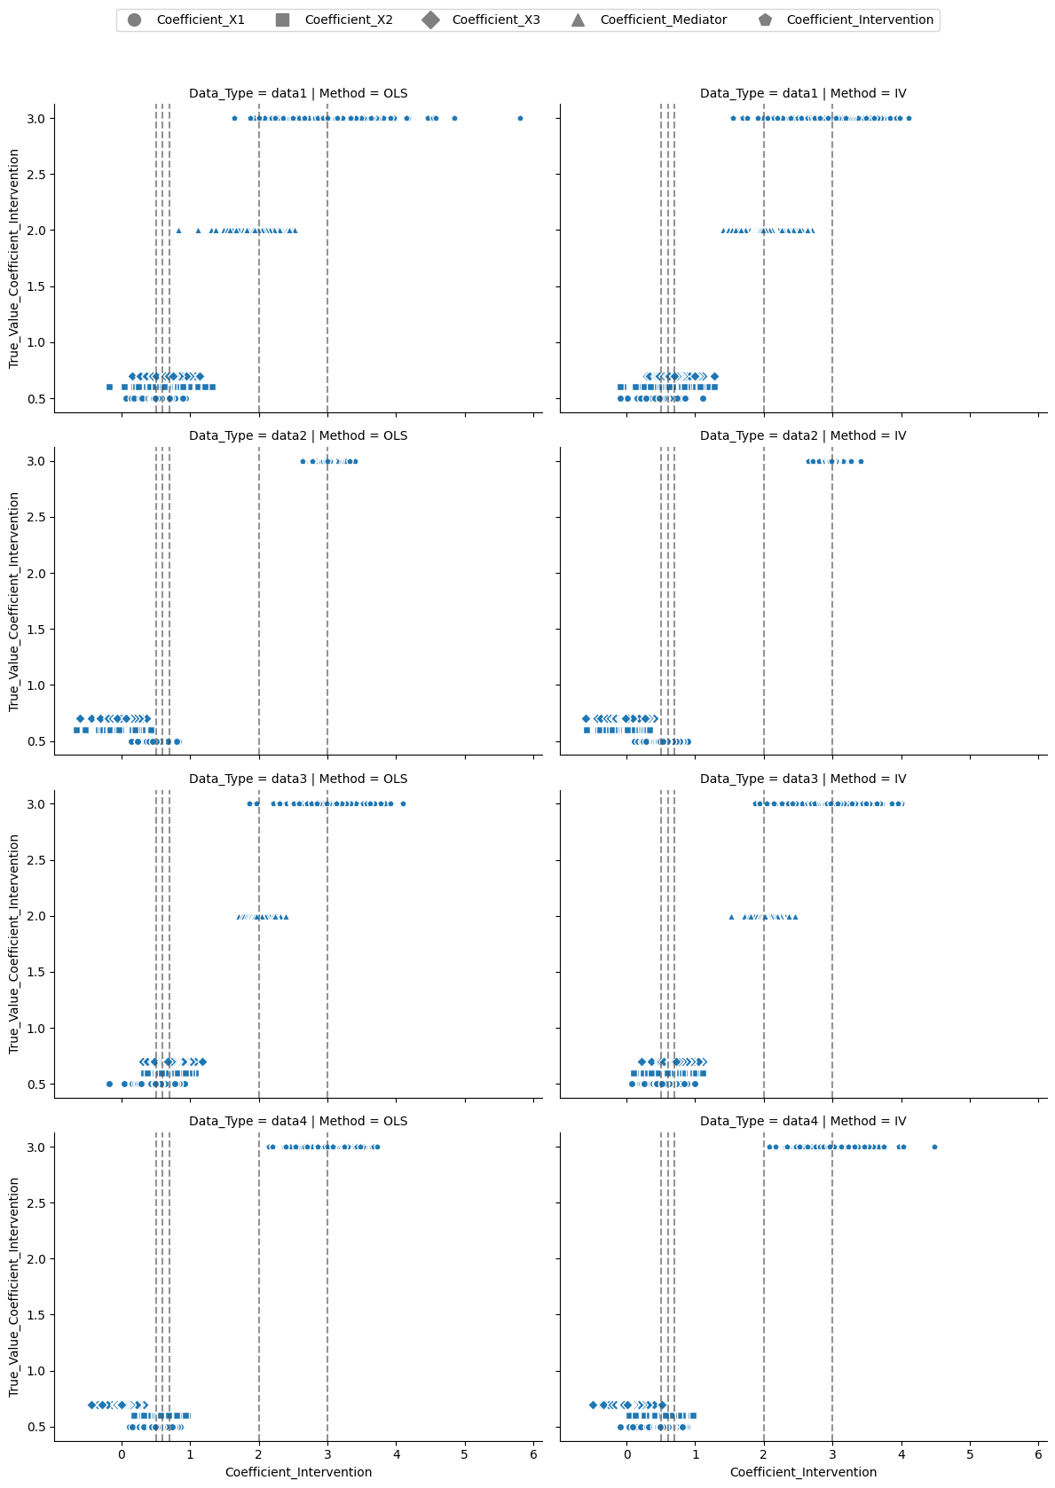
= 0.5
= 0.6
= 0.7
= 2
= 3
Data 1
True Values
Data 2
True Values
Data 3
True Values
Data 4
True Values
Estimated Coefficients

Slide 17
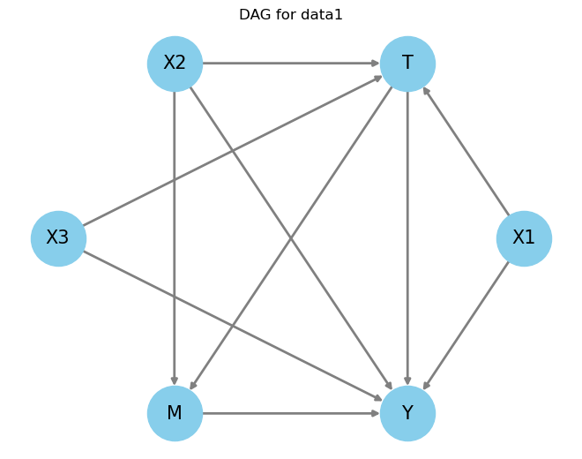

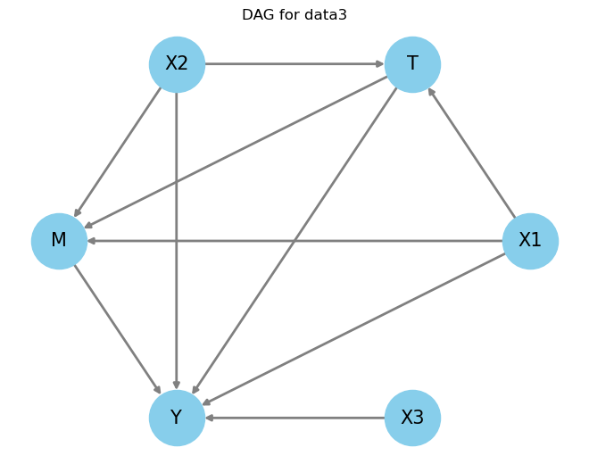









Slide 18


statsmodels (OLS) | DoWhy with Graphs (No predefined) | Dowhy w/o Graphs (No predefined) | DoWhy with Noise Graphs | DoWhy with Graphical Assumption (Cofounding) | NN -CFNN
Direct Effect | Total Effect | Direct Graph |  | Direct Effect: All remaining variables are controlled – backsteps are manually blocked | Predict Counterfactual outcome dropout +batch normalization Early stopping ,Adam+ learning rate 0 .001
Train data: ols Test data: ols | Train data: coefficients, intercepts estimate Test data: Calculate MAPE with estimated coefficients and intercepts
4 data types 3 sample size (50, 100, 1000) for training 1 sample size (1000) for test iteration : 100 |  |  |  |  | X: Common Causes T: Intervention Y: Outcome M: Mediator
OLS: Predicted_Y = ols.fit ->predict_Y Dowhy Total Effect: Predicted_Y = intercept + T* Causal_effect Direct Effect: Predicted_Y = intercept + T*Coeffieict_T + X1*Coeff_X1 ... |  |  |  |  | Predicted outcome Causal effect Error - treatment (compare to synthetic) RMSE MAPE + coefficient comparison (OLS vs DOWHY)
Notes:
Storyline, cleararity, method, efficiency, ; quality of the doc

Slide 19
Method |  | Causal effect Error - treatment (compare to synthetic) |  |  |  | RMSE |  |  |  | MAPE
 |  | data1 | data2 | data3 | data4 | data1 | data2 | data3 | data4 | data1 | data2 | data3 | data4
OLS | OLS | 2.980015 | 2.997508 | 3.025788 | 3.002985 | 1.004609 | 0.999507 | 1.003676 | 0.999417 | 165.901555 | 112.917713 | 67.517319 | 108.921028
 | OLS IV | 1.314508 | 1.689359 | 1.657531 | 2.009710 | 1.085407 | 1.649402 | 1.092251 | 1.080448 | 94.353343 | 80.508003 | 72.790272 | 77.878168
DoWhy | No assumptions | 7.875684 | 3.119502 | 7.659048 | 3.724732 | 2.098624 | 1.100287 | 2.828897 | 1.218973 | 132.263201 | 170.930835 | 273.555776 | 106.213170
 | Total Effect with Graphs | 6.996398 | 2.999586 | 7.005180 | 3.009200 | 2.445608 | 1.118811 | 2.843923 | 1.273213 | 111.214811 | 146.574038 | 422.447197 | 155.072832
 | Total Effect with Graphs + Assumptions | 7.003056 | 3.002144 | 6.993155 | 2.994976 | 2.443595 | 1.115239 | 2.842612 | 1.272468 | 379.847935 | 148.375797 | 346.681036 | 98.539470
 | Total Effect with Graphs + Noise | 7.049098 | 0.807026 | 6.997600 | 1.546680 | 2.417655 | 4.389843 | 2.846820 | 3.336170 | 191.153811 | 115.018138 | 287.428819 | 119.201149
 | Direct Effect with Assumptions | 3.008007 | 3.002003 | 3.003361 | 3.001502 | 1.416740 | 1.418326 | 1.412575 | 1.418540 | 99.638080 | 181.790117 | 143.345810 | 87.297167
 | Direct Effect with Graphs + Assumptions | 2.993926 | 3.116640 | 3.009257 | 3.021316 | 12.423295 | 2.108689 | 1.825239 | 1.412502 | 400.612579 | 291.902906 | 172.956156 | 81.240721
Counterfactual Neural Network | Counterfactual Neural Network
CausalNex- Bayesian Network | CausalNex- Bayesian Network

Slide 20
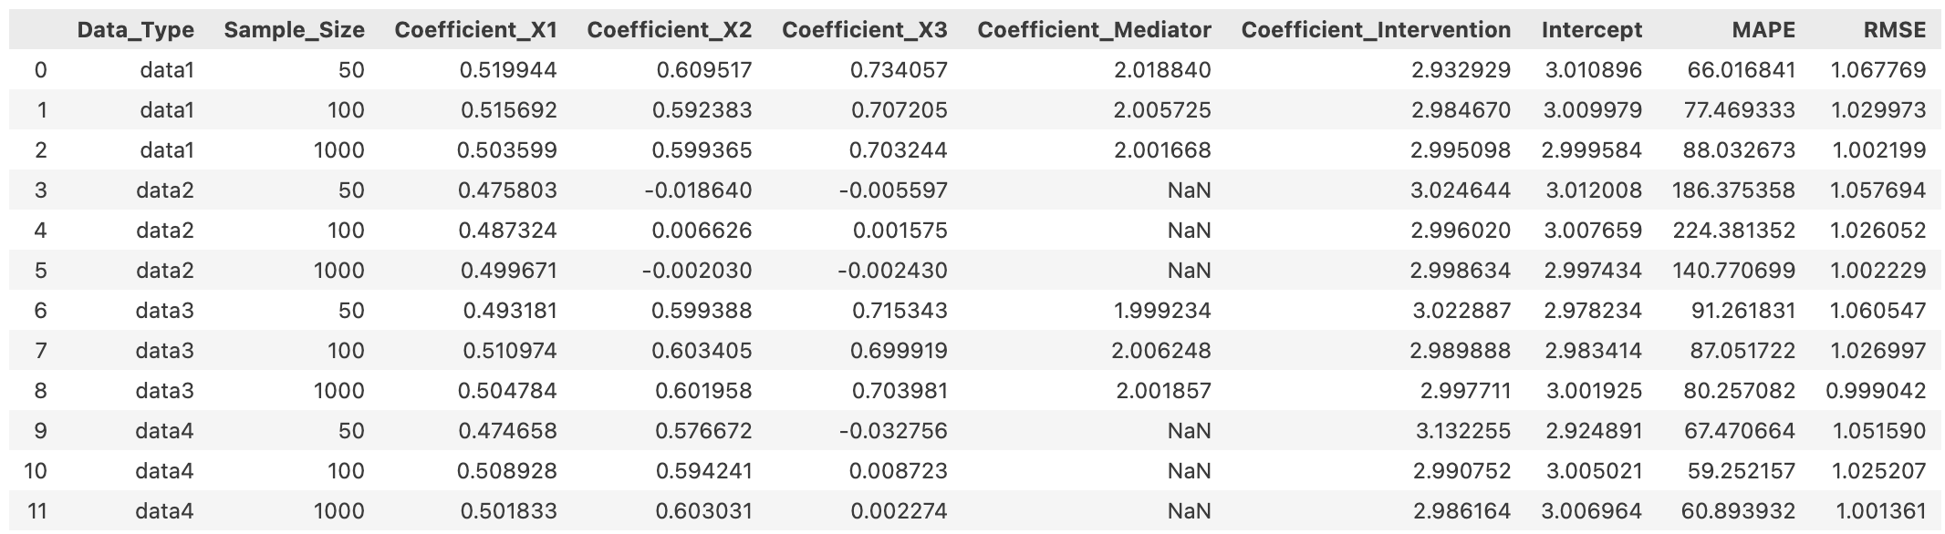
OLS
DataType (4)
Sample Size (3)
50, 100, 1000
Iteration (100)
Sample size: training
!000: test

Slide 21
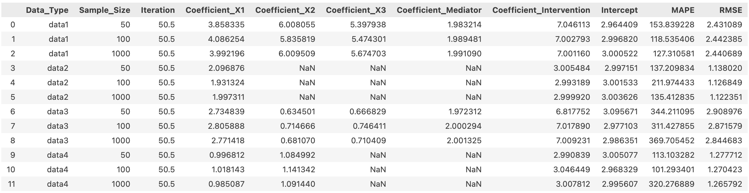
DoWhy – with graph
DataType
Sample Size
Iteration (100)
Only Graphs
Using Total Effect to calculate the MAPE, RMSE
50, 100, 1000
averaged_df_DoWhy_TEG

Slide 22
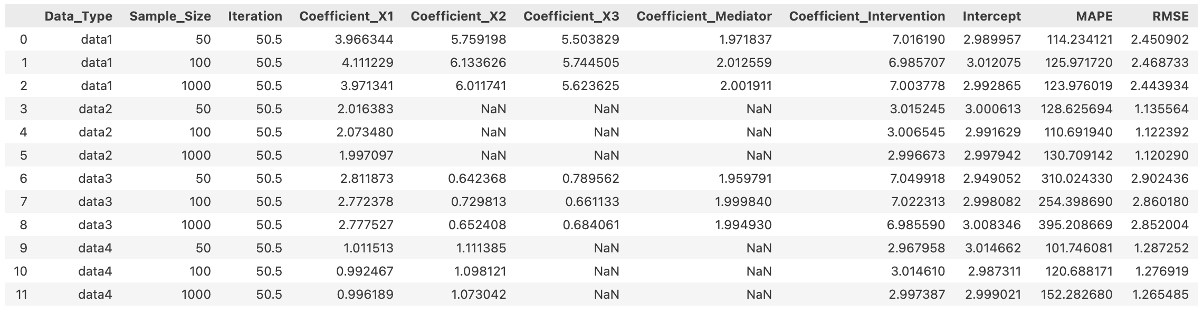
DoWhy – with graph +Common Causes, Instrument
DataType
Sample Size
Iteration (100)
Graphs + Additional Information
Using Total Effect to calculate the MAPE, RMSE
50, 100, 1000

Slide 23
DoWhy – with graph Noise
DataType
Sample Size
Iteration (100)
Grpahs + Noise
Using Total Effect to calculate the MAPE, RMSE
50, 100, 1000

Slide 24
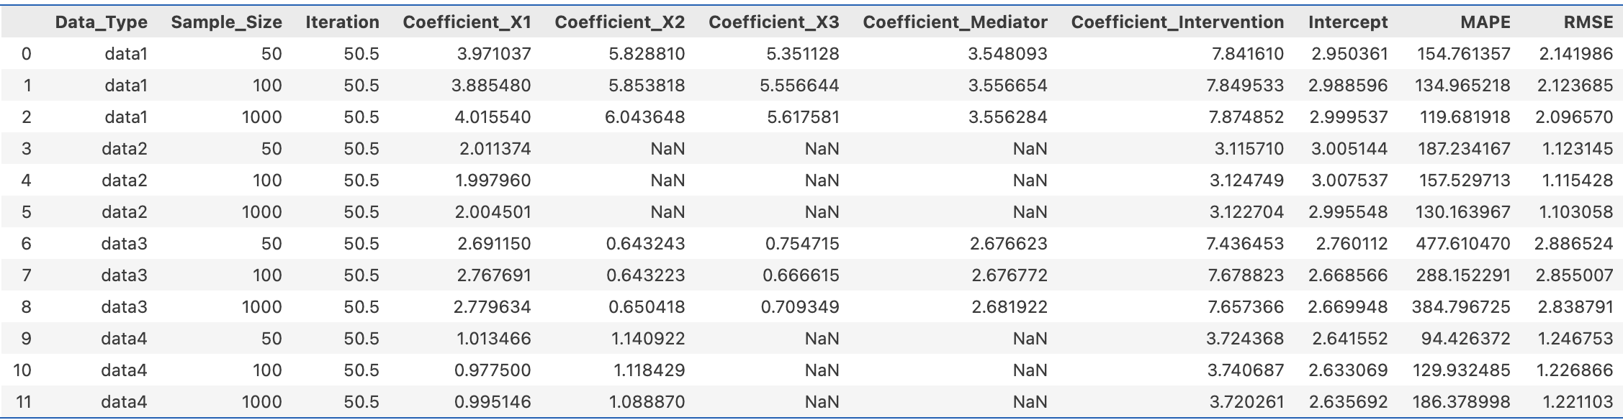
DoWhy – without any assumptions
DataType
Sample Size
Iteration (100)
No Information
Using Total Effect to calculate the MAPE, RMSE
50, 100, 1000

Slide 25
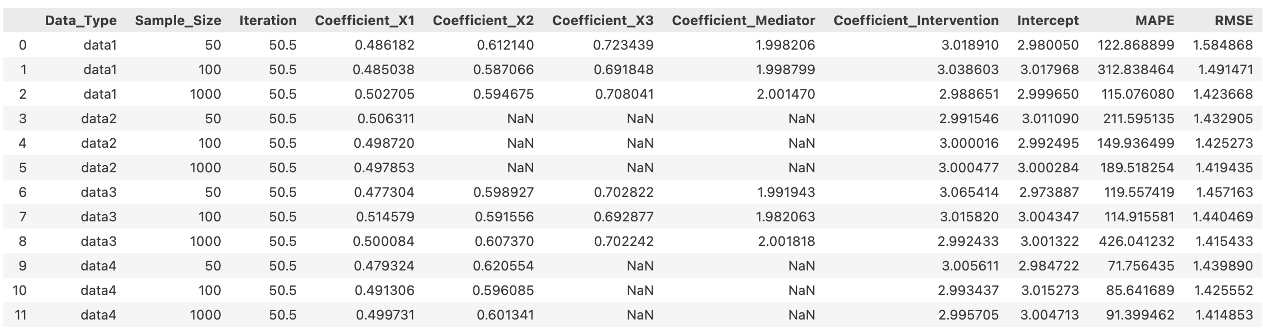
DoWhy – with all remaining variables as Common causes
DataType
Sample Size
Iteration (100)
All remaining - Common Causes
Using Direct Effect to calculate the MAPE, RMSE
50, 100, 1000

Slide 26


DoWhy – with graph and assumptions
DataType
Sample Size
Iteration (100)
All remaining - Common Causes
Using Direct Effect to calculate the MAPE, RMSE
50, 100, 1000
Treatment before
Treatment after
Control before
Control after
Randomly Assign to Treatment or Control Groups

Slide 27
Data Information: The data is divided into different datasets labeled as "data1," "data2," "data3," and "data4." Each dataset has varying sample sizes (e.g., 100, 500, 1000) and is associated with different methods for causal analysis.
Metrics: The data includes several metrics used to evaluate the performance of the different causal methods:
MAPE (Mean Absolute Percentage Error)
RMSE (Root Mean Squared Error)
Coefficients for various features (X1, X2, X3, Mediator) and interventions
Intercept
Method used for analysis (e.g., OLS, IV OLS, DoWhy, CFNN)

Slide 28
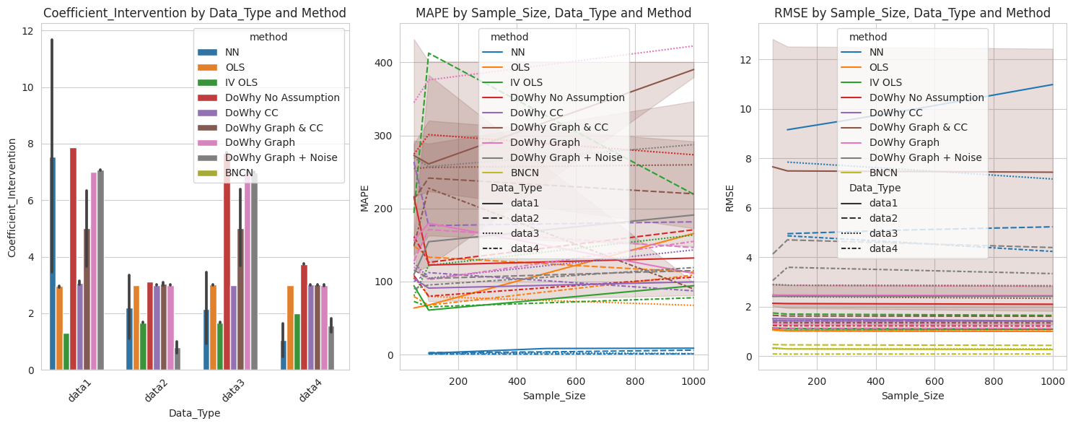

Slide 29
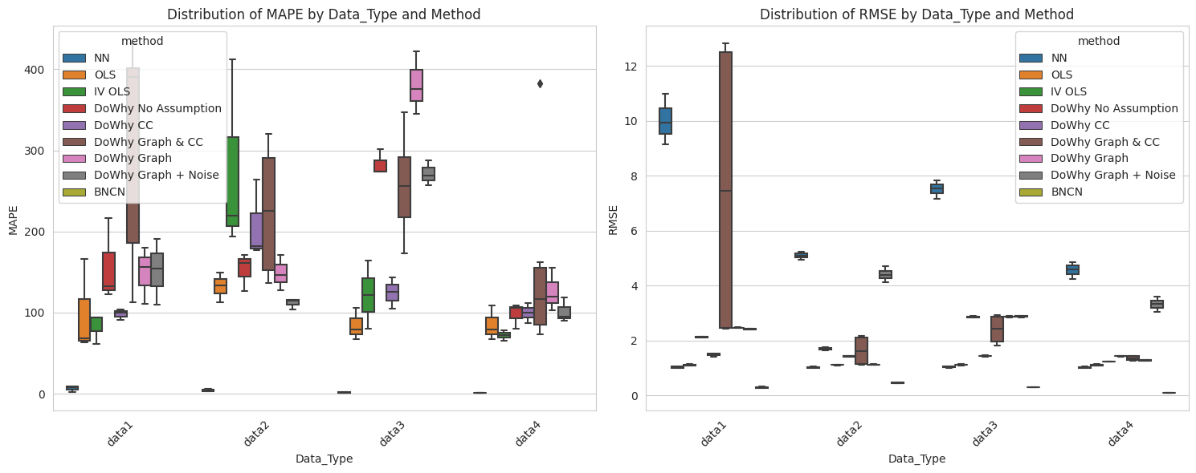

Slide 30
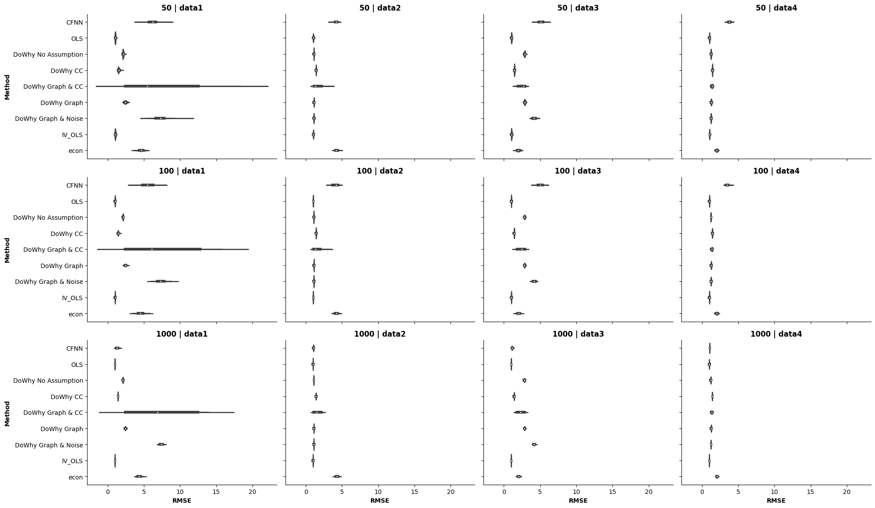
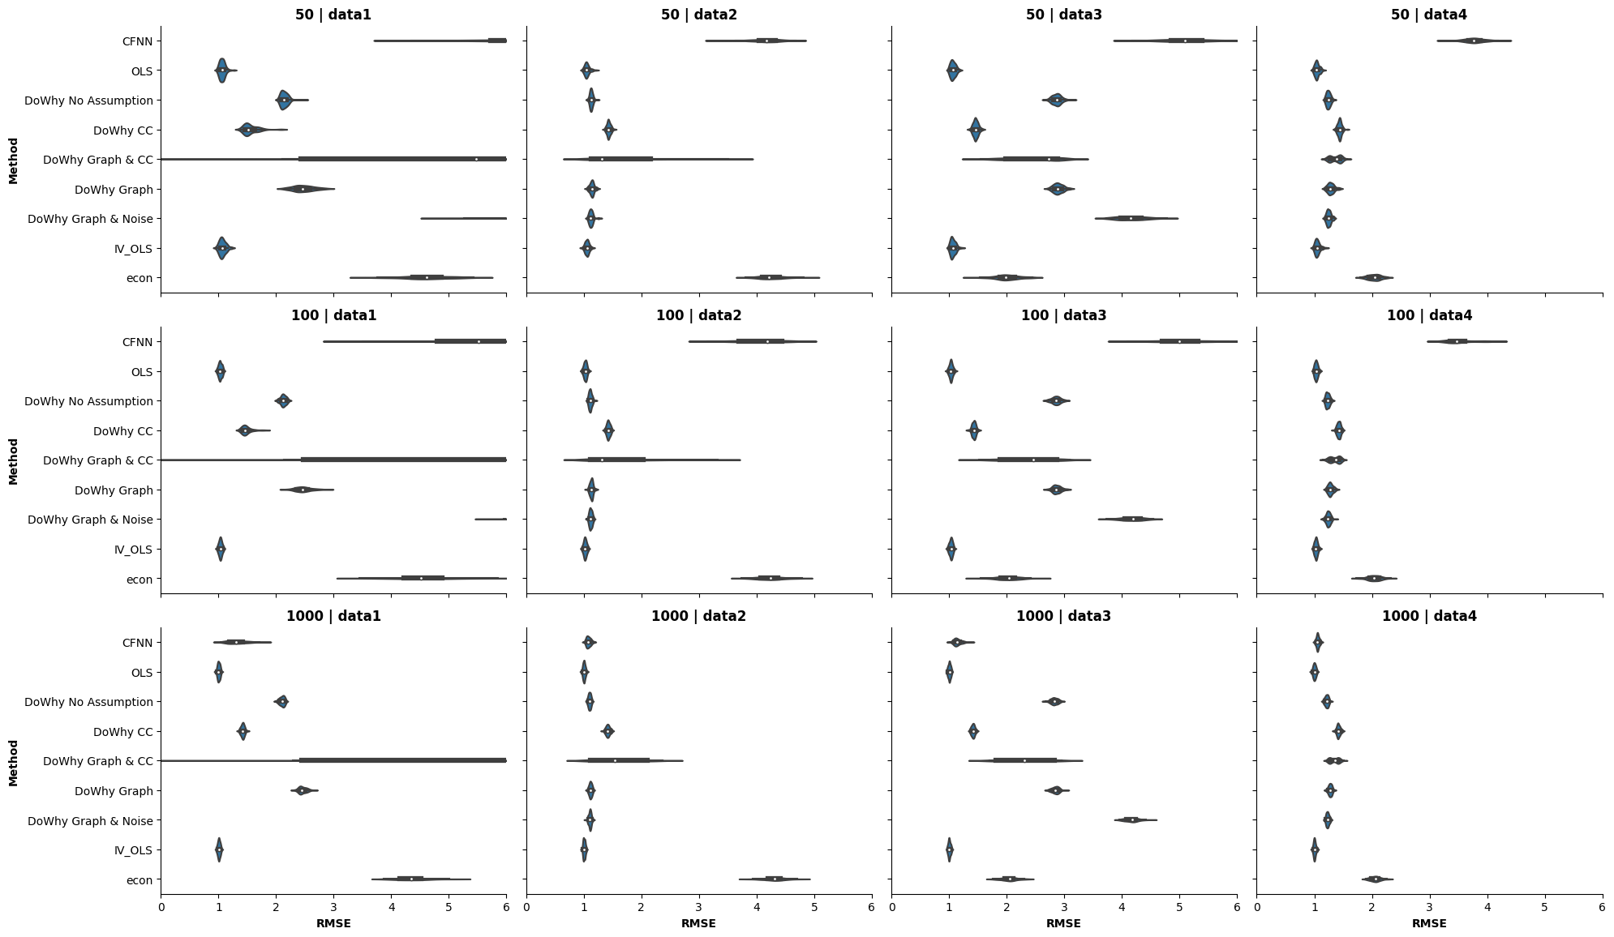
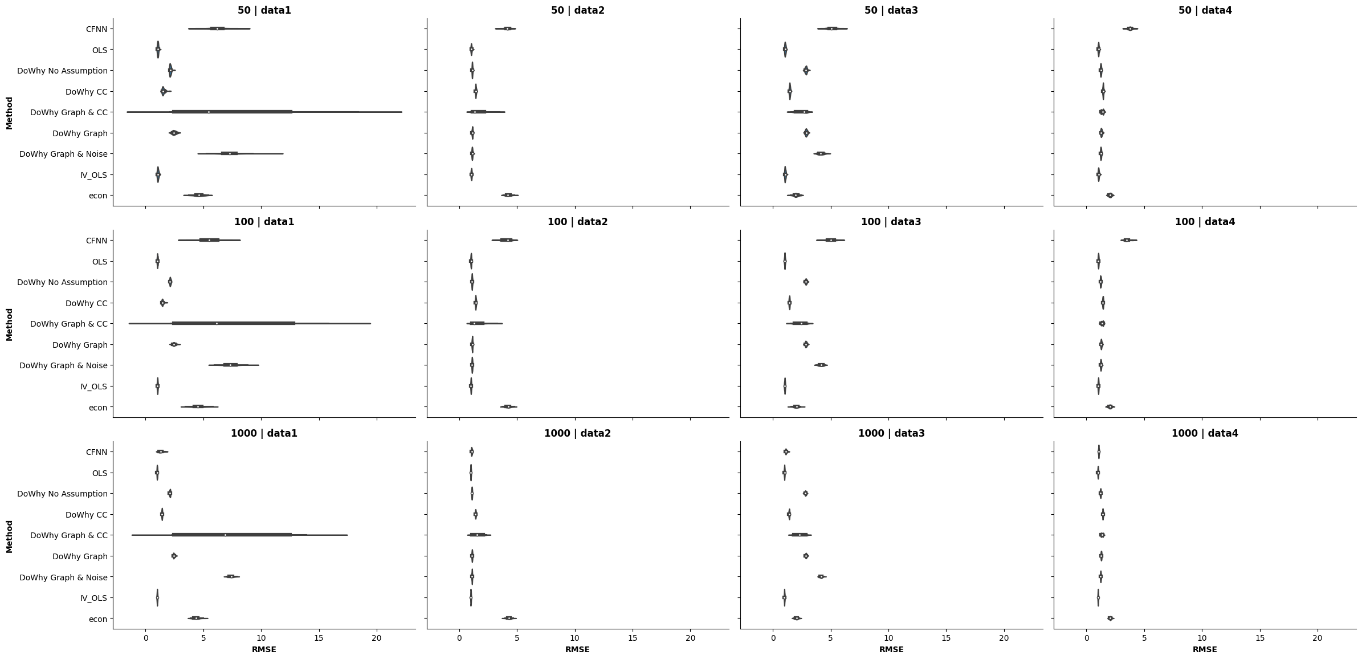

Slide 31
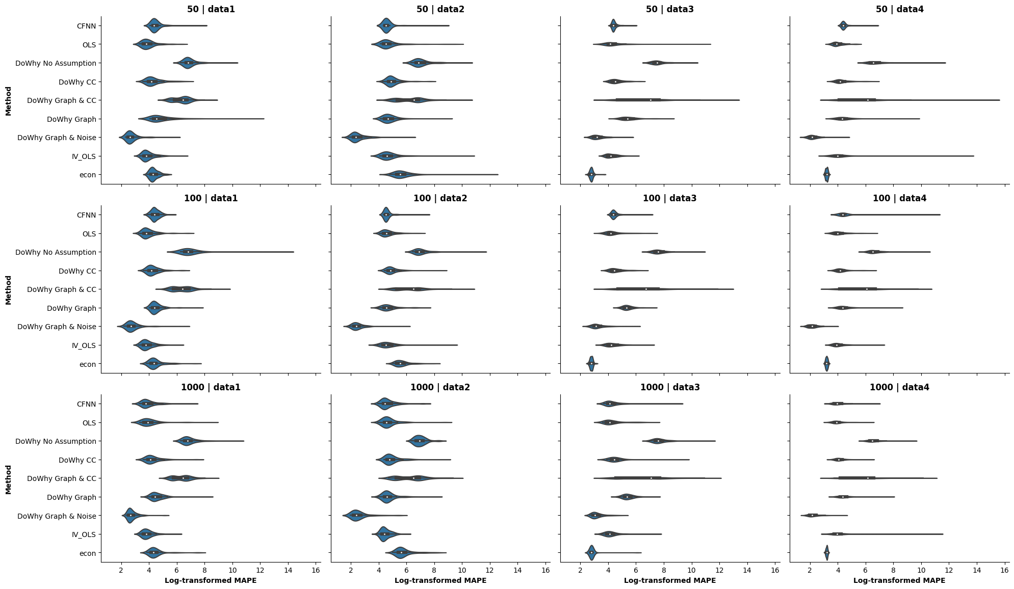

Slide 32
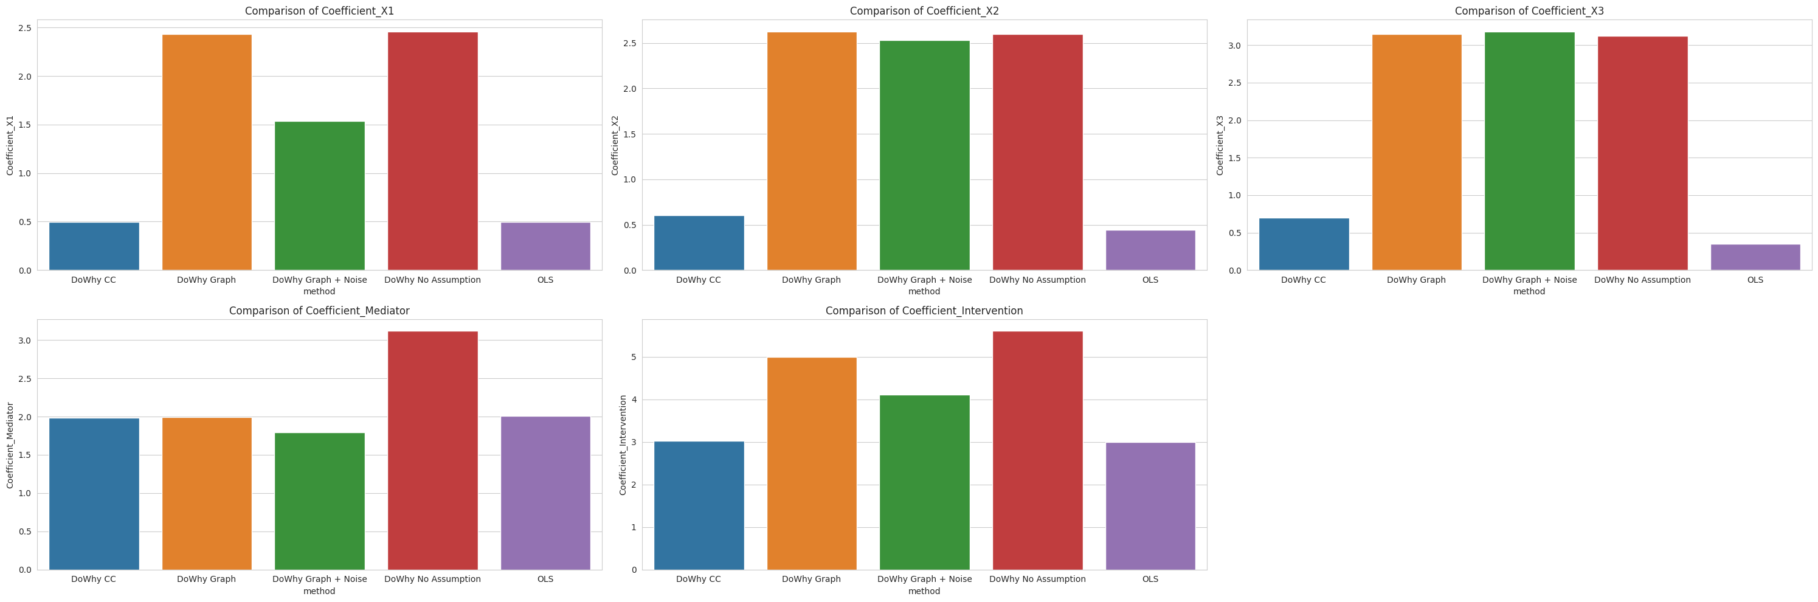
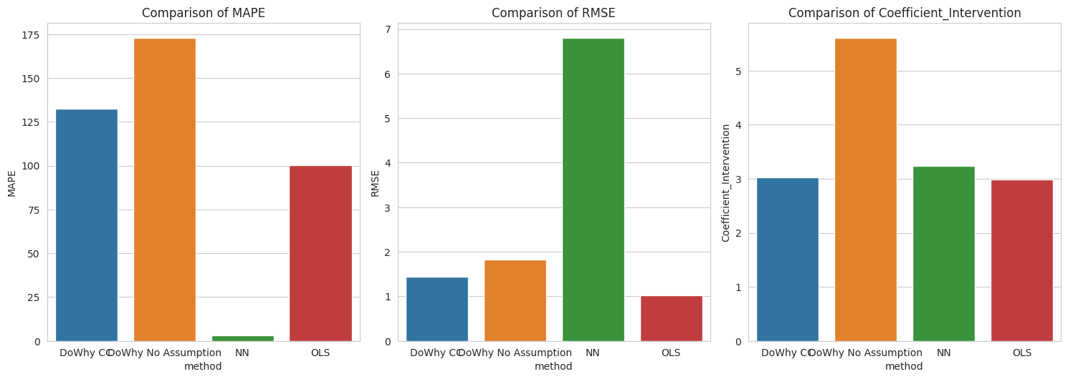

Slide 33
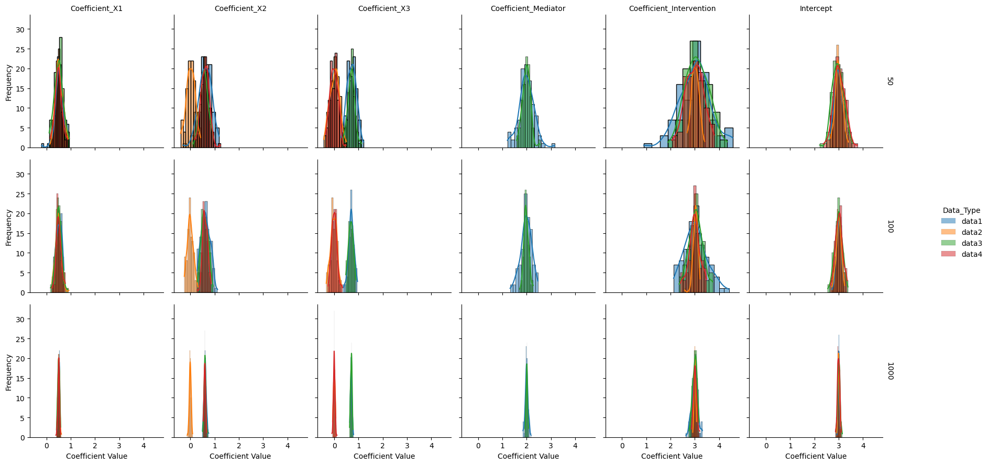

Slide 34
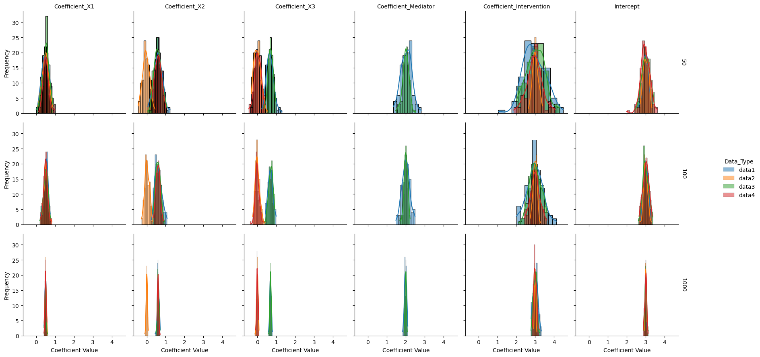
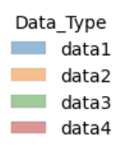
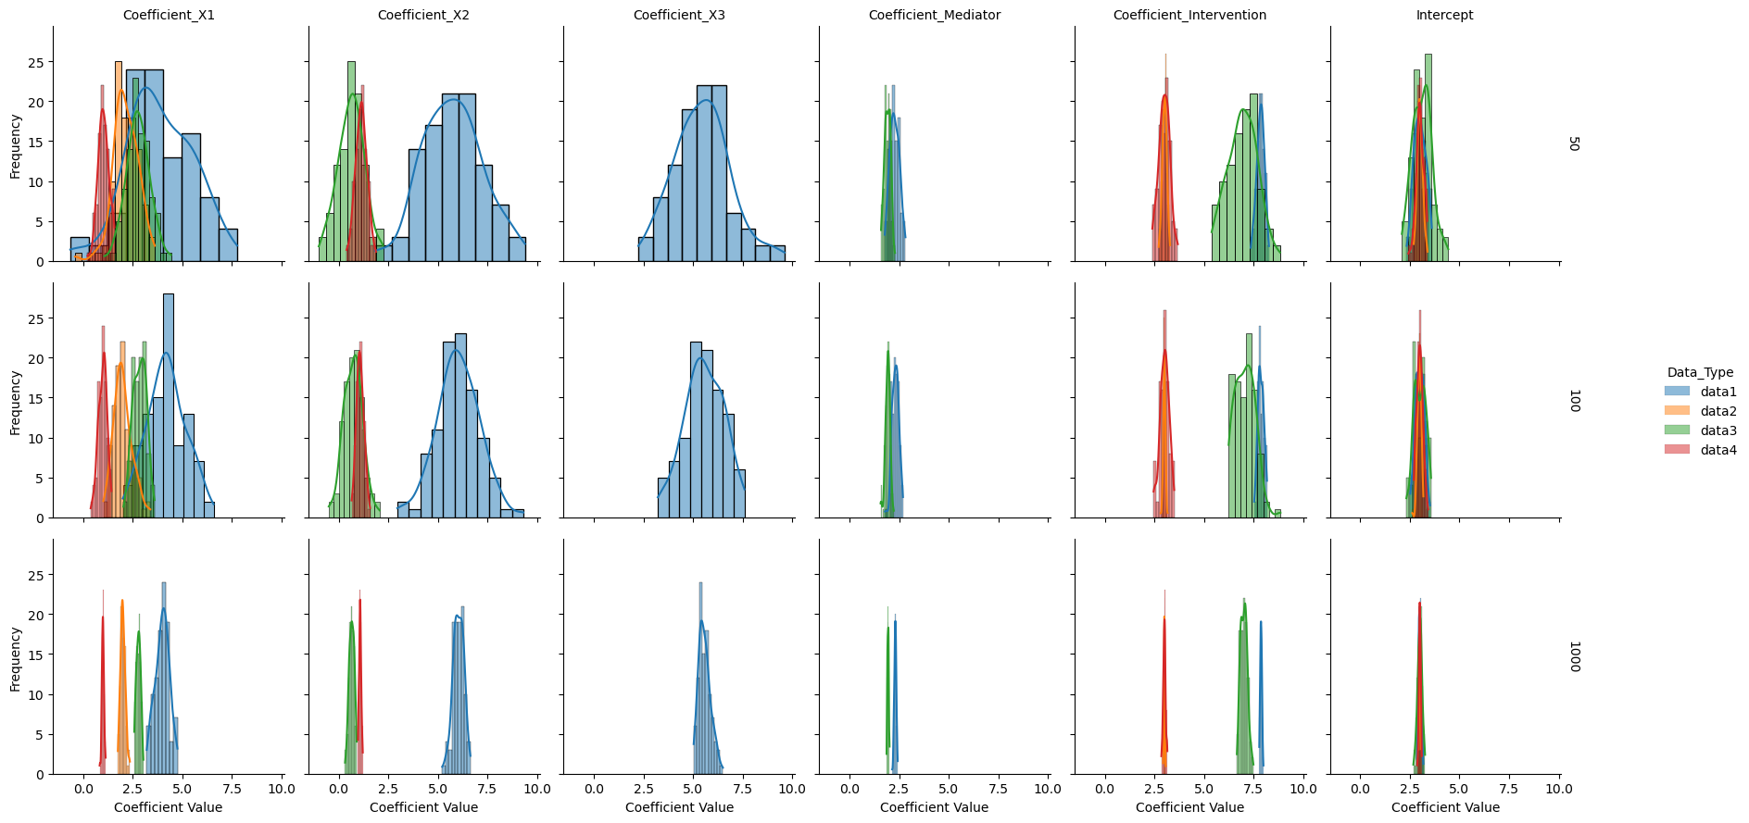

Slide 35
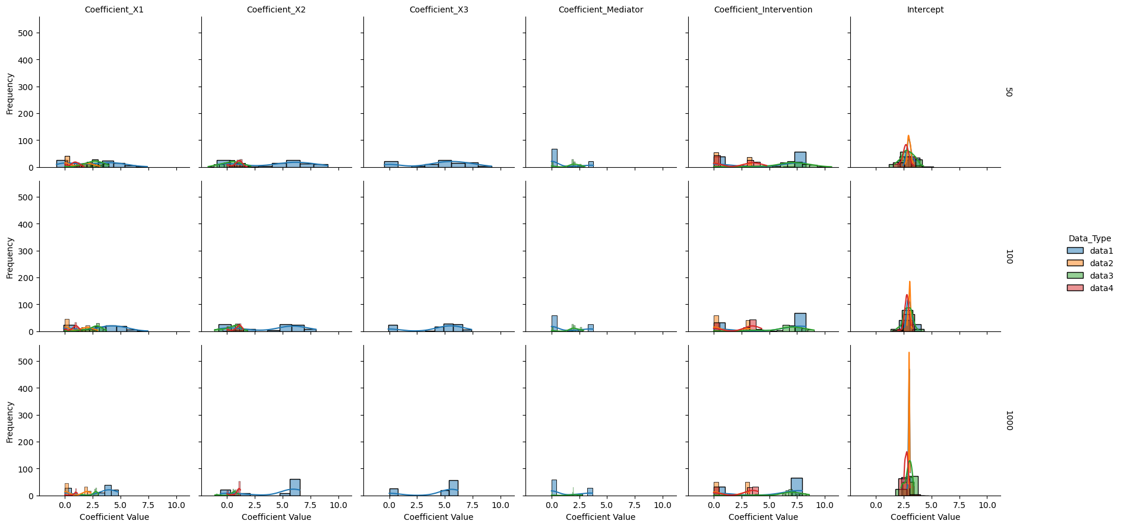

Slide 36
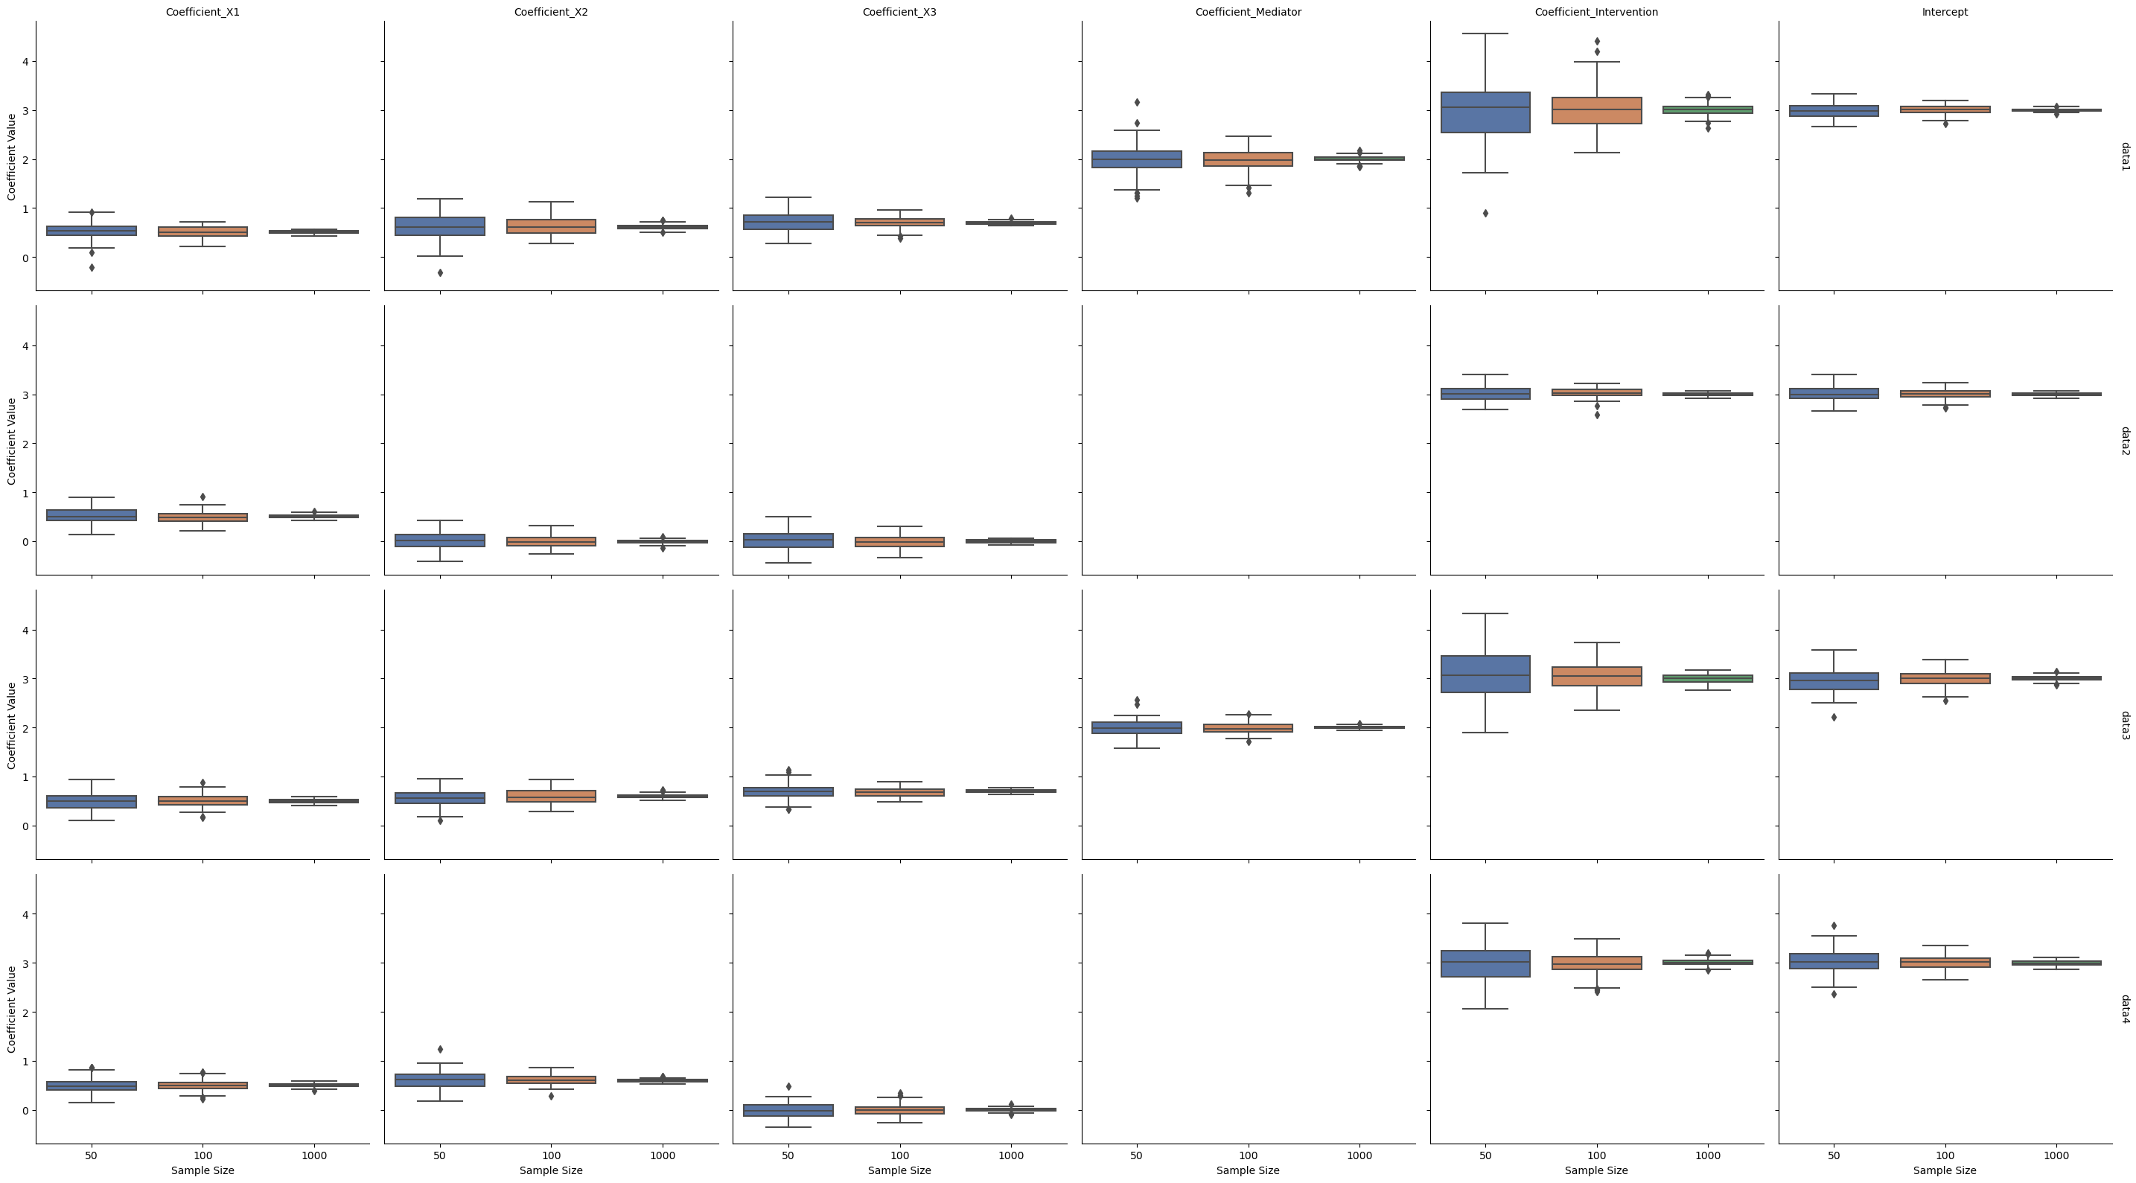


Slide 37


Slide 38


Slide 39


Slide 40


Slide 41


Slide 42







Slide 43

https://www.google.com/url?sa=i&url=https%3A%2F%2Fnc233.com%2F2020%2F04%2Fcausal-inference-cheat-sheet-for-data-scientists%2F&psig=AOvVaw1MZOmRXDGLz3F7FGFD866s&ust=1691479513255000&source=images&cd=vfe&opi=89978449&ved=0CBMQjhxqFwoTCJDul66CyoADFQAAAAAdAAAAABAE

Slide 44
Research Design
Python Libraries | Methods
DoWhy | Methods based on estimating the outcome model - Linear Regression Generalized Linear Models Conditional Treatment data: The input data provided to the causal model. treatment: The treatment variable (also known as the cause or the intervention). outcome: The outcome variable (also known as the effect or the response). common_causes: A list of common causes that affect both the treatment and the outcome. instruments: A list of instrumental variables used for handling endogeneity. effect: The estimated causal effect of the treatment on the outcome. identified_estimand: The estimand object representing the causal effect being estimated. estimator: The causal estimator used to compute the effect (e.g., 'linear_regression', 'iv_regression', etc.). estimate_effect: A method to estimate the causal effect based on the causal model. refute_estimate: A method to refute or test the causal effect estimation using different techniques.
CausalML | regression-based methods, tree-based methods, and neural network-based methods
EconML
CausalNex | Bayesian Network
Whether these are included in or not: Structural Inference, Inference of the causal effect

Slide 45
Python Libraries
Library | Causal Method | Benefits | Usages | Outcome | References
DoWhy | Provides a unified interface for causal inference methods based on graphical models | Allows for clear structuring of causal problems and is robust to modelling assumptions. Good for counterfactual analysis | Seamless and unified API, Provide end-to-end solution for causal inference which are useful and handful for any users including non-experts. | Estimant, Causal effect, | DoWhy Documentation
CausalML | Implements techniques in causal inference using ML algorithms (Meta-Learners-estimate CATE, Instrumental Variable methods etc.) | Integrates causal inference with powerful machine learning techniques | Conditional Average Treatment Effect, Targeting Optimization, Engagement Personalization, | Causal effect | CausalML Documentation
EconML | Uses ML to solve econometric and causal inference problems (double ML, instrumental variables, orthogonal random forests etc.) | Allows estimation of causal effects while controlling for confounders. Robust to specific ML model specifications | Estimate individualized causal responses from observational or experimental data |  | EconML Documentation
CausalNex | Uses Bayesian Networks to infer causal relationships | Can discover and validate causal relationships. Handles missing data and can forecast effects of interventions | Suitable when understanding directional relationship between variables and how changes propagate through a system is required |  | CausalNex Documentation
statsmodels | Basic SEM – Generalized

Slide 46
Method | Process | Pros | Cons
Instrumental Variables | Find an instrumental variable | - Addresses endogeneity and confounding | - Requires identifying a valid instrumental variable
 | Estimate causal effect using IV regression | - Useful for observational studies with hidden variables | - Assumes exclusion restriction and validity of IV
 |  | - Provides consistent estimates
Structural Equation | Model causal relationships using latent variables | - Allows modeling complex causal systems | - Requires knowledge of causal structure and measurement
Modeling (SEM) | Test causal relationships between variables | - Enables simultaneous estimation of multiple equations | - May require large sample sizes for accurate estimation
 |  | - Can handle measurement error and missing data | - Sensitive to model misspecification and assumptions
Linear Regression | Fit linear model with treatment variable | - Simple and easy to implement | - Assumes linear relationships and constant treatment effect
 | Estimate causal effect as treatment coefficient | - Provides interpretable results | - Susceptible to confounding and omitted variable bias
Double Machine | Train two regression models to predict outcome and | - Reduces bias in causal effect estimation | - Requires larger sample sizes than single models
Learning (DML) | treatment variables | - Can handle non-linear relationships | - Complexity increases with higher-dimensional data
 | Compute residuals and estimate causal effect | - Combines machine learning flexibility with regression | - Prone to overfitting and model selection bias
Meta-Learners | Train models to estimate outcomes and treatment | - Provides estimates for heterogeneous treatment effects | - Requires larger sample sizes for accurate estimation
 | Simulate unobserved outcomes and calculate ITEs | - Can handle non-linear relationships and high dimensions | - Complex and computationally intensive
 | Combine ITE models using a weight function | - Can account for confounding and endogeneity | - Sensitive to model specification and selection bias

Slide 47


Slide 48





Slide 49




Causal effect estimate: 1.501604909551876 Causal effect confidence intervals: Interval 1 Lower bound: 1.4907508896088633 Upper bound: 1.512458929494887

Slide 50



Causal effect estimate: 1.4956843594383553 Causal effect confidence intervals: Interval 1 Lower bound: 1.4764917473962462 Upper bound: 1.5148769714804649

Slide 51





Causal effect estimate: 7.865951502552157
Causal effect confidence intervals: Interval 1
Lower bound: 7.857769740221236
Upper bound: 7.8741332648830715
Causal effect estimate: 7.865951502552157
Causal effect confidence intervals: Interval 1
Lower bound: 7.857769740221236
Upper bound: 7.8741332648830715

Slide 52




Slide 53


Slide 54




Slide 55




Slide 56


Regression
Dowhy + Regression

Slide 57



Variables in the dataset
Initial_Thickness | Age | Allowable_Stress | Pressure | OD | Required_Thickness | Anode_life | Thickness | Corrosion_Rate | Remaining_Life | OC (RL < 5, 0, 1) | T (Anode >0 , 1, 0)
Continuous | Continuous | Continuous | Continuous | Continuous | Continuous | Continuous | Continuous | Continuous | Continuous | Binary | Binary
DoWhy
DoWhy +EconML

Slide 58

https://www.kaggle.com/code/jyotiprasadpal/graphical-models-cancer-dataset

Slide 59



Material --> Allowable_Stress
Pressure, OD, Allowable_Stress --> Required_Thickness
Initial_Thickness, Age, Anode_life --> Thickness
Initial_Thickness, Thickness, Age, Anode_life --> Corrosion_Rate
Thickness, Required_Thickness, Corrosion_Rate, Age, Anode_life --> Remaining_Life
Mediator

Slide 60

Synthetic Data Generation Process
 | Intervention (Anode_life or Damages, Explosion) | Mediator | Confounders | Outcome (Remaining Life of pipeline)
data1 | Continuous | Yes | 3 | Continuous
data2 | Continuous | No | 3 | Continuous
data3 | Binary | Yes | 3 | Continuous
data4 | Binary | Yes | 3 | Binary

Slide 61

EDA - Pairplot

Slide 62
Evaluation Metrics
Evaluation Metric | Formula/Calculation
Confidence Interval
Mean Squared Error (MSE) / Mean squared prediction error (MSPE) | MSE = 1/N * Σ (Yi_true - Yi_pred)^2.
Bias | Bias = E[Yi_pred - Yi_true] -> Average prediction error.
Variance | Var = E[(Yi_pred - E[Yi_pred])^2]
Propensity Score Overlap | Check histograms or density plots of propensity scores for the treated and control groups. Sufficient overlap is required for reliable causal inference.
Synthetic Control / Placebo Tests | This involves conducting an "experiment" where you know the true causal effect (e.g., the synthetic control group, or the placebo test). Your estimated treatment effect should match the known true effect.
Computation time | Check and Compare the computation time using ”time” module

Slide 63


Causal Structure Evaluation

Slide 64

Confidence Intervals over the different treatments – CausalML
Modeling cause-effect relationships with causal mechanisms — DoWhy documentation (petergtz.github.io)

